Slide 1
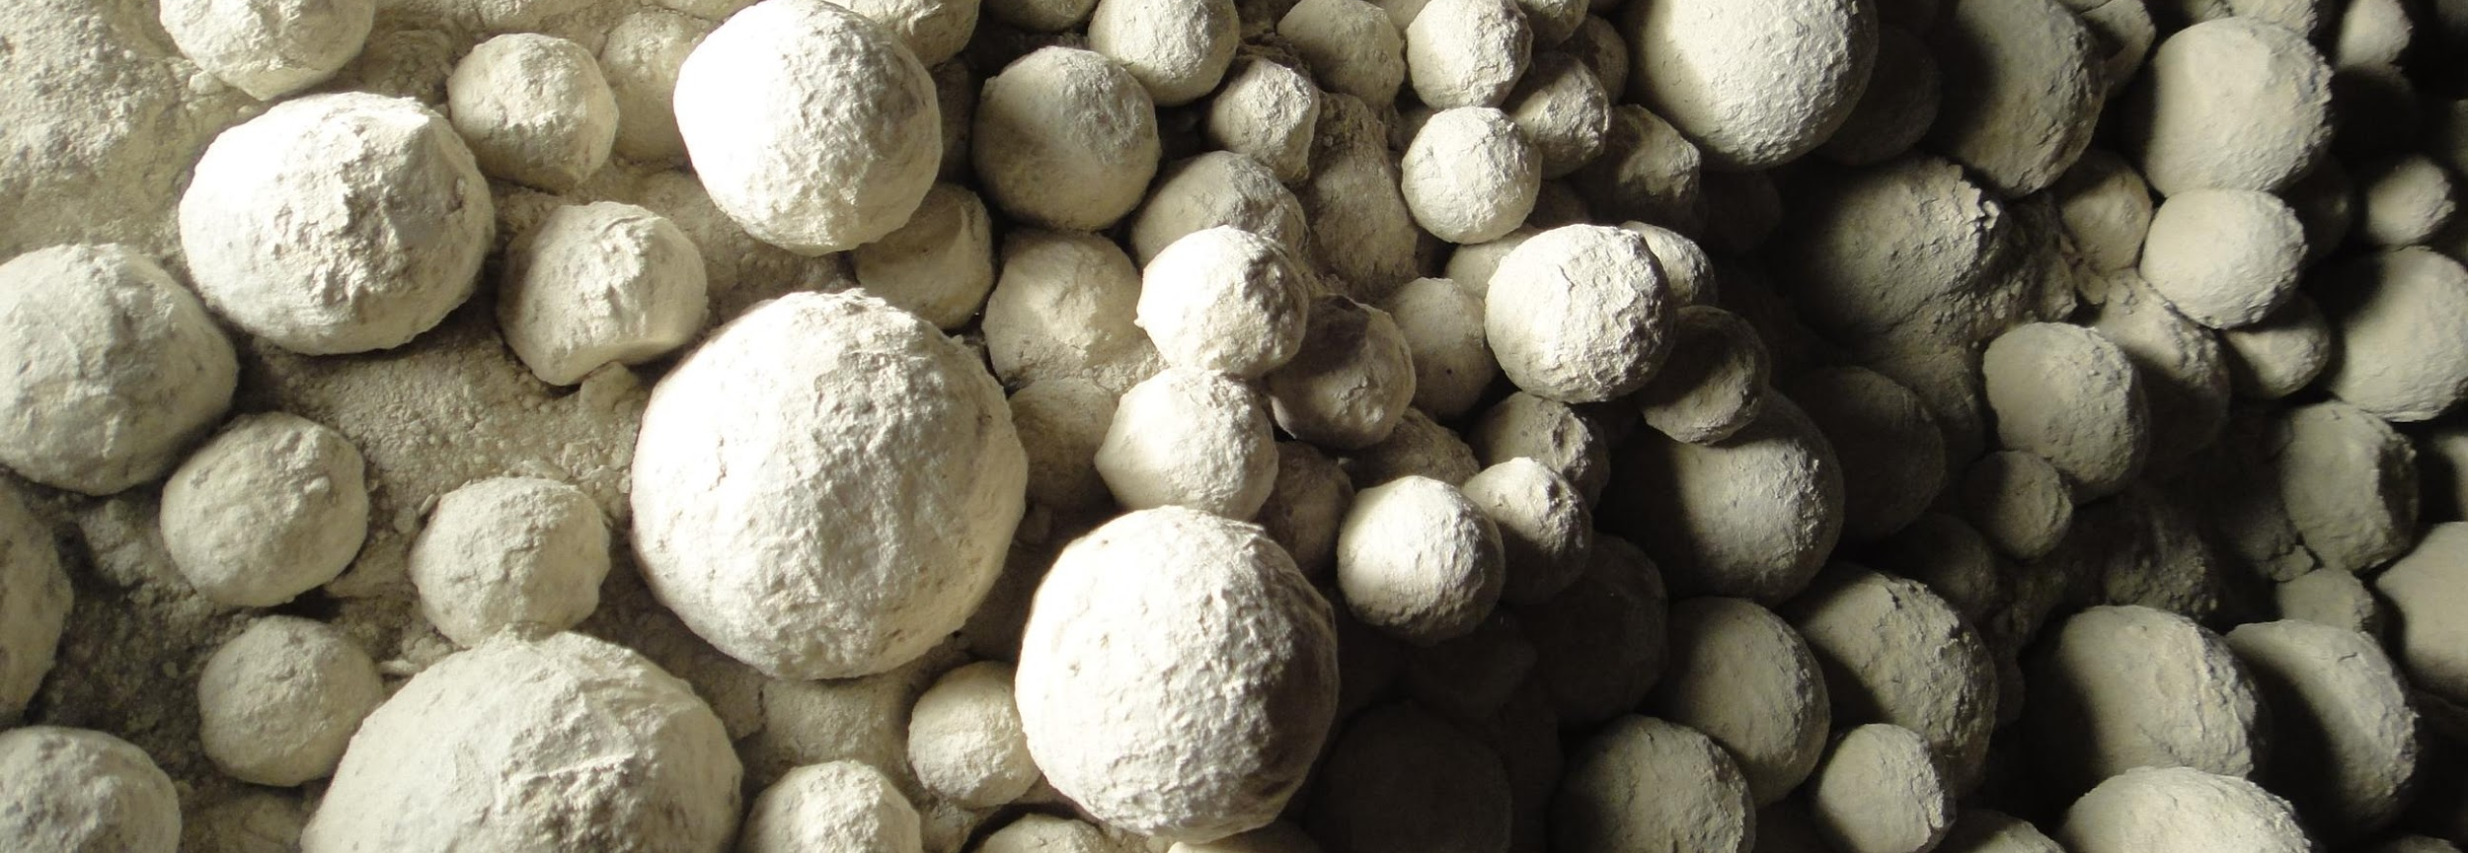
Ball Mill Optimization Drying and Cooling (incl. Heat balance)
Technical Development Program for Process Performance Engineer 2015 - 2016

Slide 2
Content
Objectives
Purpose of ball mill ventilation
B – level audit of ball mills
Explanation of measurement tasks and requirements
Comparison with guide values
Heat balance of a ball mill system
Drying potential in a ball mill and lack of drying
Cooling potential in a ball mill and lack of cooling
Conclusion

Slide 3
Content
Objectives
Purpose of ball mill ventilation
B – level audit of ball mills
Explanation of measurement tasks and requirements
Comparison with guide values
Heat balance of a ball mill system
Drying potential in a ball mill and lack of drying
Cooling potential in a ball mill and lack of cooling
Conclusion

Slide 4
Objectives
Understand the purpose of the ventilation in a ball mill
Recognize the importance of ventilation for drying or cooling of the material
Know which measurements to perform in the context of a B – level audit
Become familiar with the fundamentals of a heat balance of a ball mill grinding circuit
Learn, how to overcome a lack of cooling or drying

Slide 5
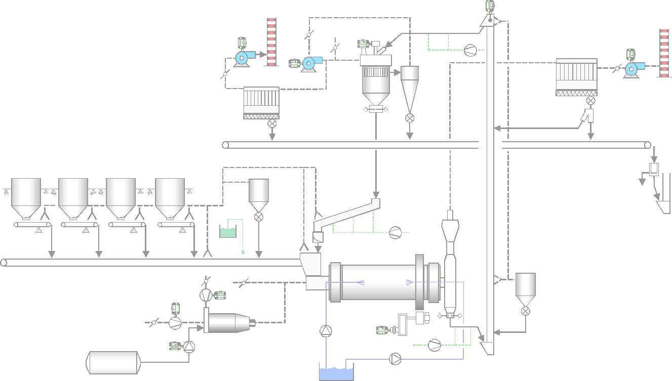
The Comminution Process Chain
Crushing
Drying
Coarse grinding (*)
Fine grinding
Separating
Grinding tool management
Ventilation & cooling
Operation
Control
(*) Includes pregrinding and the grinding in the 1st chamber

Slide 6
Content
Objectives
Purpose of ball mill ventilation
B – level audit of ball mills
Explanation of measurement tasks and requirements
Comparison with guide values
Heat balance of a ball mill system
Drying potential in a ball mill and lack of drying
Cooling potential in a ball mill and lack of cooling
Conclusion

Slide 7
Purpose of Ball Mill Ventilation
The need of ventilating a ball mill system properly is to maximize the grinding efficiency and to fully exploit the drying and cooling potential by performing the following tasks:
Material transport inside mill (especially of the fines)
Removal of ultrafines (avoid coating on the balls)
Cooling of cement with fresh air (avoid lump formation in silo and change of setting times, avoid coating on the balls)
Drying of raw materials or mineral components of composite cements with hot gases (from kiln system or from a hot gas generator)
Lowering of the dew point temperature of the cement mill gas
Keeping the mill under negative pressure

Slide 8
Content
Objectives
Purpose of ball mill ventilation
B – level audit of ball mills
Explanation of measurement tasks and requirements
Comparison with guide values
Heat balance of a ball mill system
Drying potential in a ball mill and lack of drying
Cooling potential in a ball mill and lack of cooling
Conclusion

Slide 9
B – level audit (tasks and objectives)
B-level audit Realization
B – level audit (related to ball mill ventilation)
Tasks:
Measure the mill ventilation and critical temperatures
Calculate important gas velocities
Objectives:
Assess proper ventilation of the ball mill
Judge on potential for additional drying or cooling

Slide 10
B – level audit (Tasks & Frequency)
B-level audit Realization
one year
1. Circuit mat. granulometry
2. Mill longitudinal sieving
3. Ball charge filling degree
4. Mill material level
5. Mill internal conditions
B – level audit measurements of ball mills
6. Mill ventilation
B-level audit
7. Separator ventilation
8. Separator Tromp curve
9. Weigh feeder calibration
10. Instrument verification
11. Control loop verification
yearly stop

Slide 11
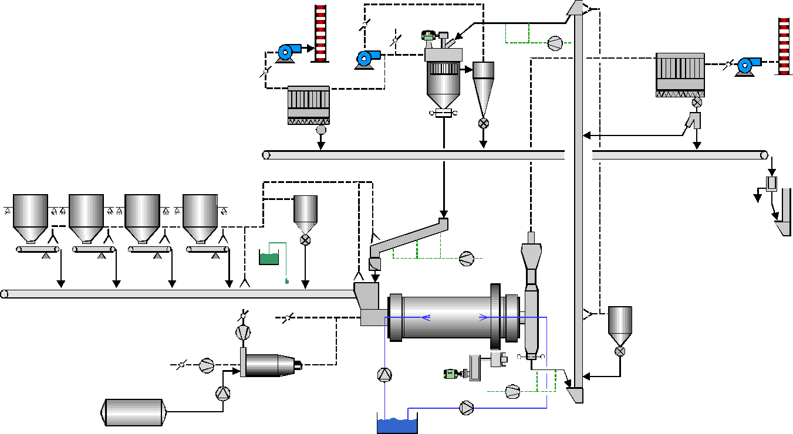
Mill & Separator ventilation measurements
B-level audit Realization
→ Static pressure, temperature
→ Airflow, static pressure & temperature
MFC
SFO
SCA
MFO
MFI
MO
HGSA
HGFA
MI
HGPA

Slide 12
Measurement evaluation (ventilation with air)
B-level audit Realization
In case of ventilation with fresh air or cooler air:
Check that difference of material and gas temperature at mill outlet is < 5 [°C]
Estimate from temperature drop of gas at mill outlet up to the filter fan the amount of false air
Calculate from flow measurement after filter and the false air calculation, the available gas flow trough the mill.
Calculate then the critical gas velocities (mill inlet, chambers, diaphragms, mill outlet housing).
Rule of thumb:
1 °C difference in temperature ~ 1.5 [%] of False Air*
* for temperature difference less than 20 [°C], false air temperature 20-30 [°C], process temperature 60-100 [°C]

Slide 13
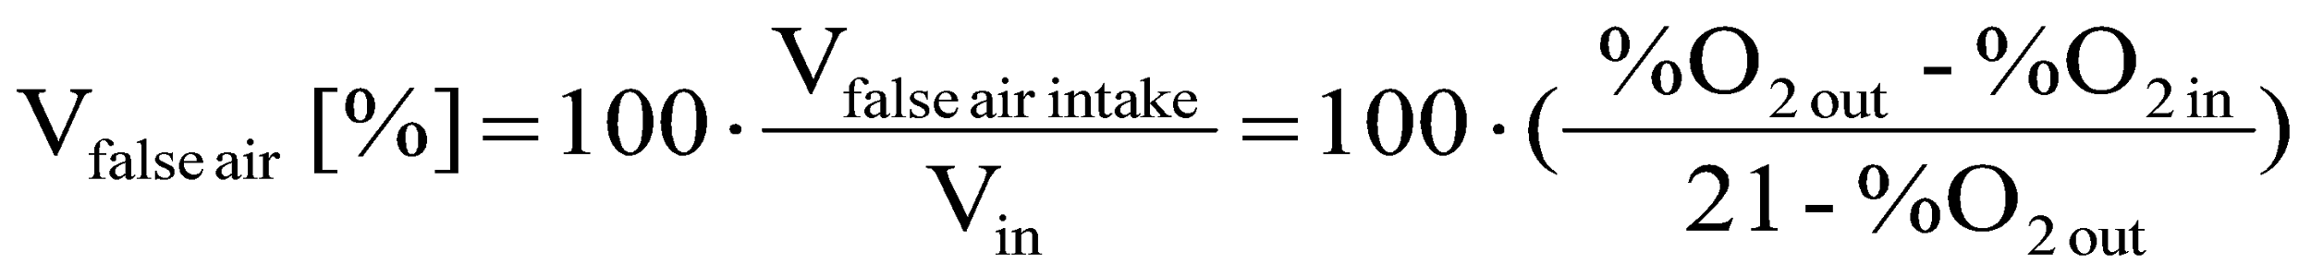
Measurement evaluation (ventilation with hot gas)
B-level audit Realization
In case of ventilation with gas from kiln or HGG:
Measure increase in oxygen from gas step by step from mill inlet / outlet to filter and calculate the amount of false air of each section
Calculate from flow measurement after filter and the false air calculation, the available gas flow trough the mill. Calculate then the critical gas velocities (mill inlet, chambers, diaphragms, mill outlet housing).
O_{2 in}
O_{2 out}
System
V_{in (100%)}
V_{out (100% + x%)}
False air _{(x%)}

Slide 14
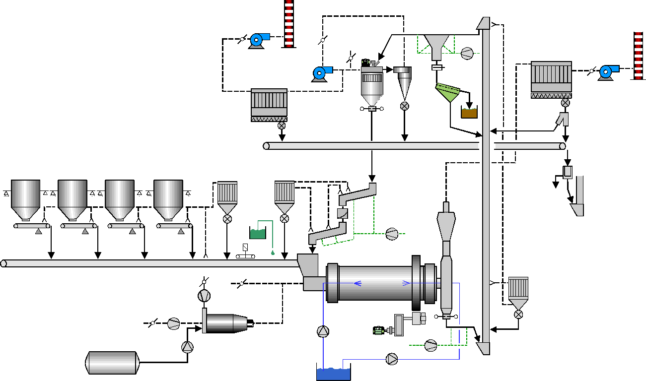
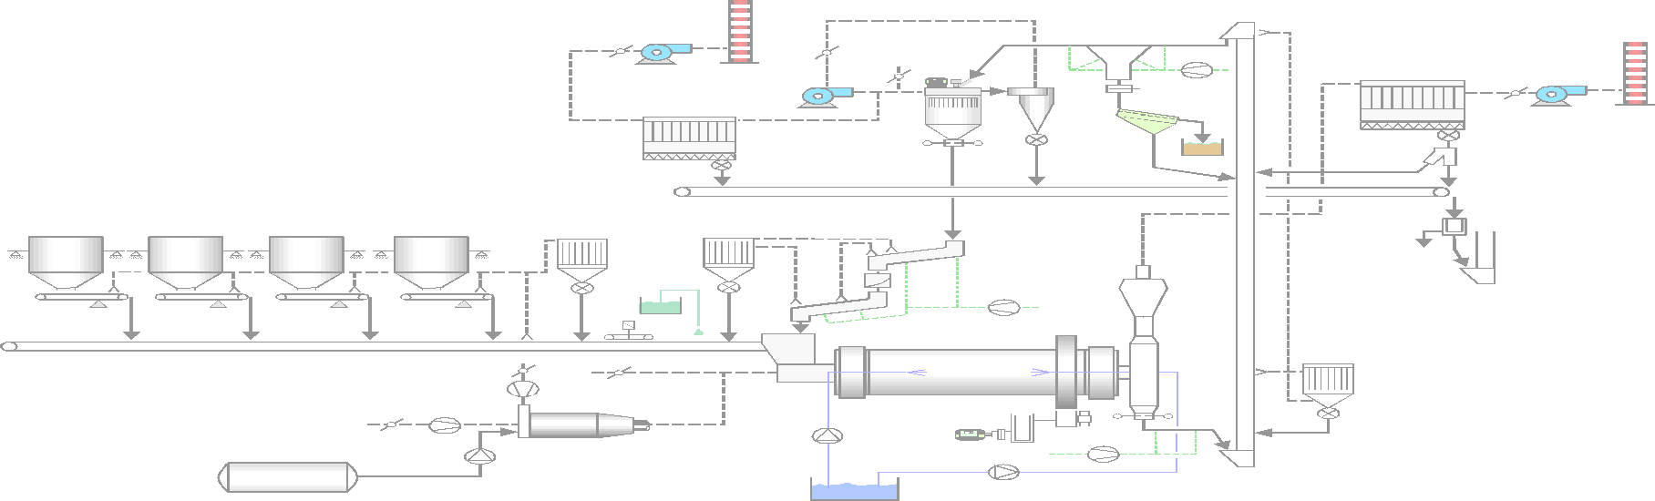
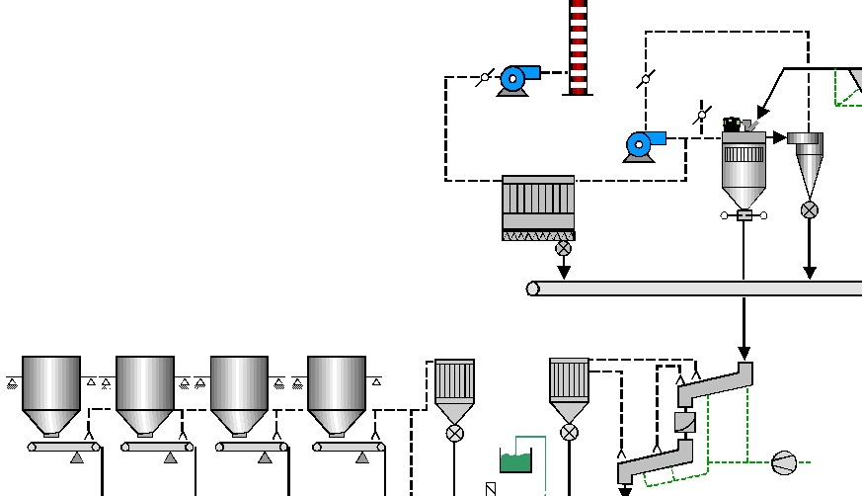
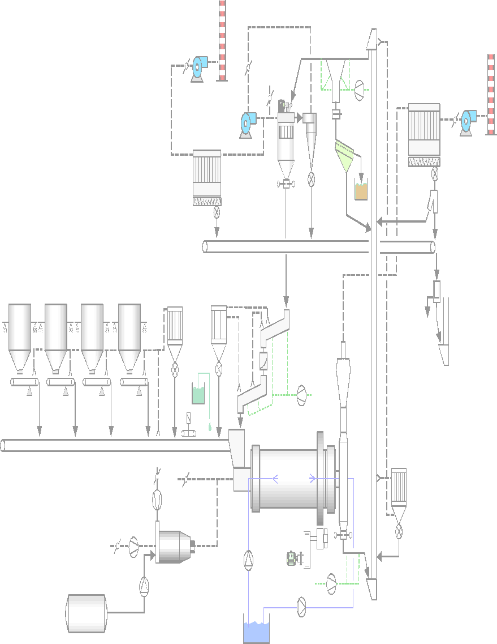
Measurement evaluation
Mill ventilation affects:
Mill outlet temperature
Filter dew point (T_{gas@ mill fan} > τ + 30 [°C])
Dew point in cement mill (T_{gas@ mill} < 55 [°C])
Product fineness at the filter
False air
Fresh air or hot gas
False air
False air reduces the cooling / drying capacity in the mill

Slide 15
Measurement evaluation
Points to be considered
Mill filter and fan are normally dimensioned only for 15 [%] false air intake into the system (mill outlet to fan) (based on a gas flow, which corresponds to 1.5 [m/s] gas velocity in the free section of the mill)
False air intakes >> 15 [%] reduce available draft in the mill
Temperature of process gas at filter must be still 30 [°C] above dew point of the gas in order to avoid corrosion problems in the filters
Dew point of the gas in the mill > 55 [°C] can result in pre-hydration of cement (reduction of strength potential)
Low pressure at mill outlet (<< 15 mbar) indicates high false air intake from mill outlet to filter and low mill ventilation

Slide 16
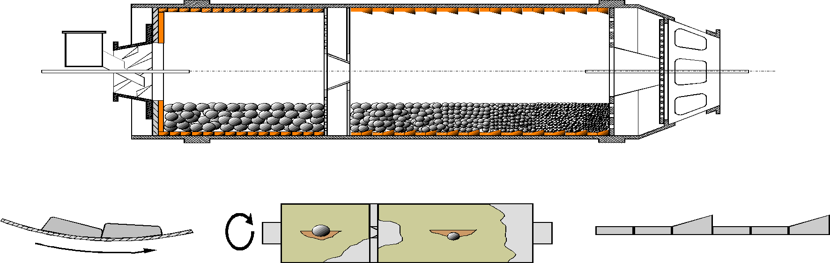
Guide values for gas velocities in the ball mill
Criteria for airflow dimensioning inside the mill (only valid for end discharge and central discharge mills – not for air swept mill)
< 25 [m/s]
V _{ball charge}
< 15 [m/s]
V _{ball charge}
< 25 [m/s]
Mill type | v _{ball charge} [m/s]*
Open circuit mill | ~ 1
Air swept mill | 5 – 6
Closed circuit raw mill | 1 – 2
Closed circuit cement mill | 1 – 1.5
* gas velocities over ball charge based on mill outlet conditions

Slide 17
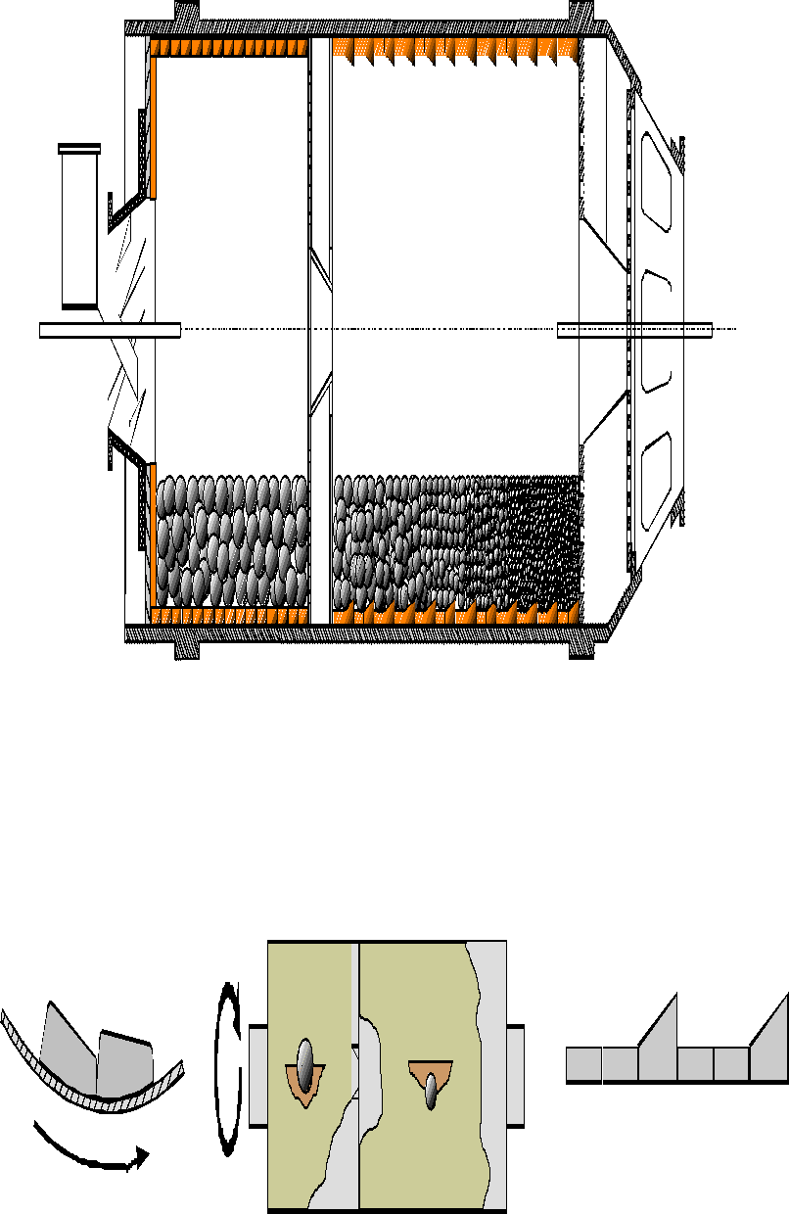
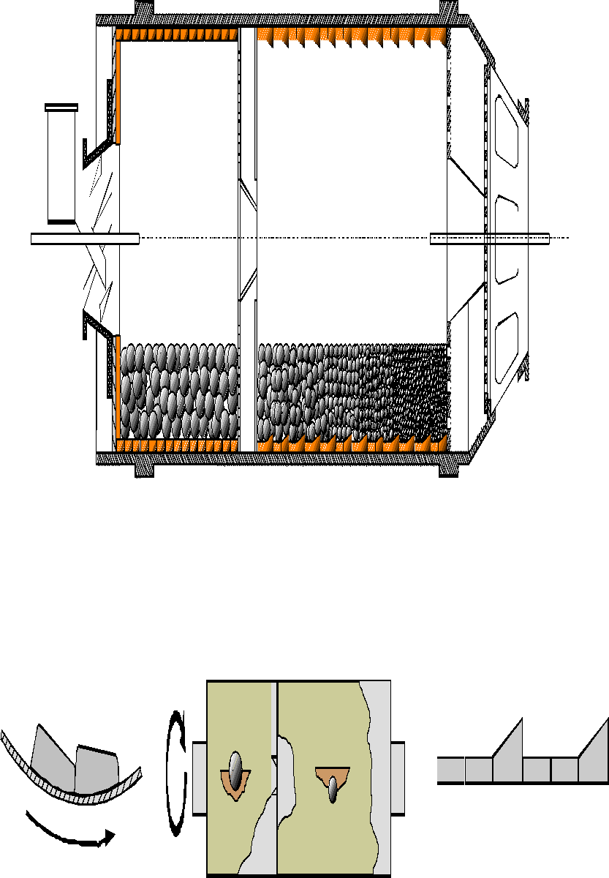
Limitation of velocities at intermediate diaphragm
bad
good
Excessive gas velocities in the center of the intermediate diaphragm (>> 15 m/sec) cause an excessively high material trajectory
Air speed reduction through the center of the intermediate diaphragm:
Install slotted back plates of the intermediate diaphragm on second chamber side (starting with external ring)
Modify material path to avoid exposure to air stream

Slide 18
Increase of mill ventilation
Most frequently ball mills suffer of an insufficient ventilation. Only few mills have a too strong ventilation.
Increase operational mill ventilation through the mill
Modify mill inlet chute to step chute type
Replace the outer ring back plates of the intermediate diaphragm by slotted plates
Optimization of outlet diaphragm and housing
Check for false air entries at the mill outlet housing, ducting and filter
Optimization of pressure drop if locally excessive
Check fan efficiency
Mill ventilation must NEVER be used for dedusting of the mill feeding / transport system or other auxiliaries

Slide 19
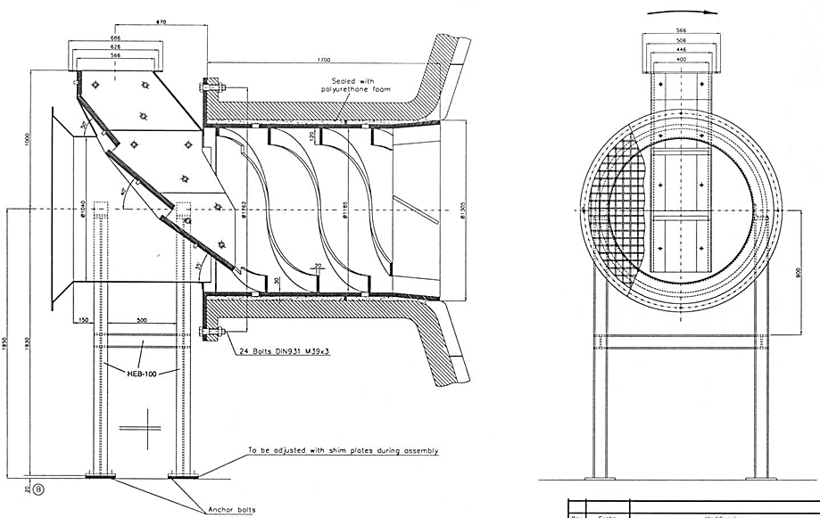
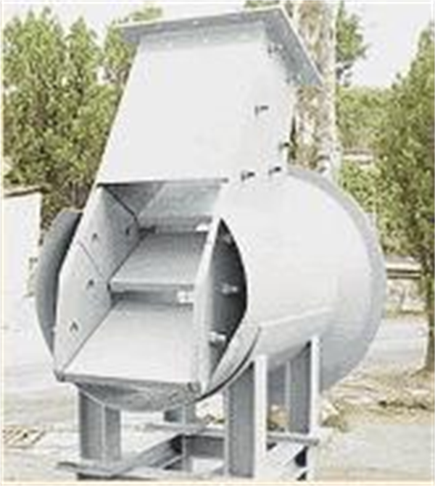
Optimization of mill inlet chute
Increase of the nominal mill ventilation with a stepped mill inlet chute

Slide 20
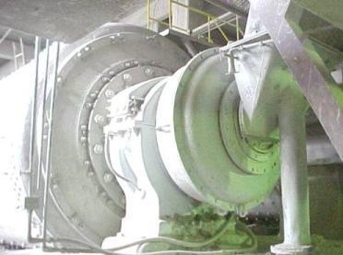
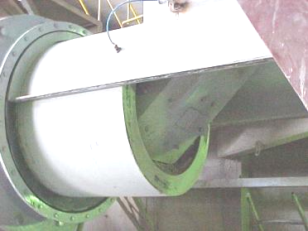
Optimization of mill inlet chute
Example BO/CM3: Increase of nominal filter capacity from 8’500 [m3/h] to 25’000 [m3/h] required also a mill inlet chute modification to allow this higher air flow in mill
Before After

Slide 21
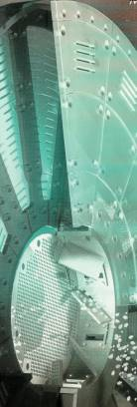
Optimization of intermediate diaphragm
Increase the nominal mill ventilation
More permeable intermediate diaphragm plates
Second chamber side (back side of diaphragm) equipped with slotted plates too (at least outer ring)

Slide 22
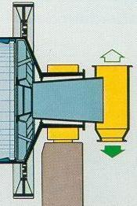
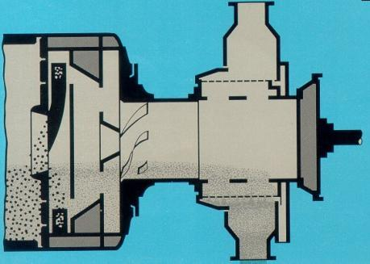
Optimization of outlet diaphragm and housing (1/2)
Central dive mill
Increase the nominal mill ventilation
Mill outlet: diaphragm, discharge cylinder and housing
Girth gear mill
Central dive mill
Material
Air

Slide 23
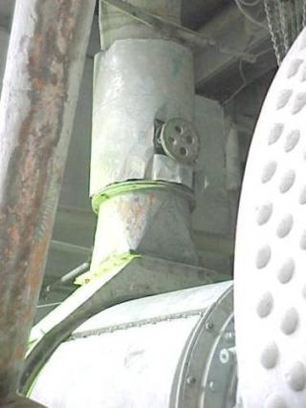
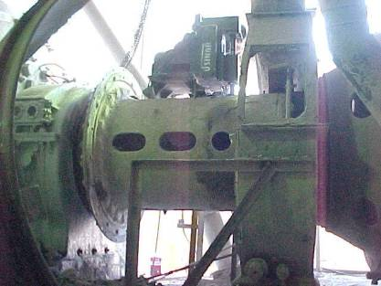
Optimization of outlet diaphragm and housing (2/2)
Increase the nominal mill ventilation
Enlarging the mill outlet casing

Slide 24
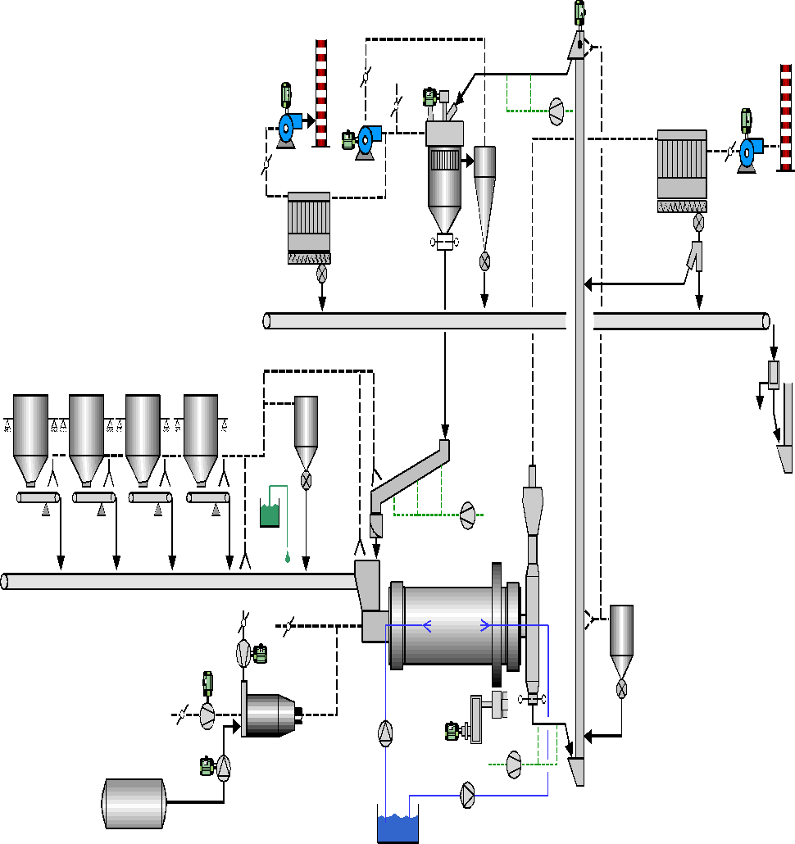
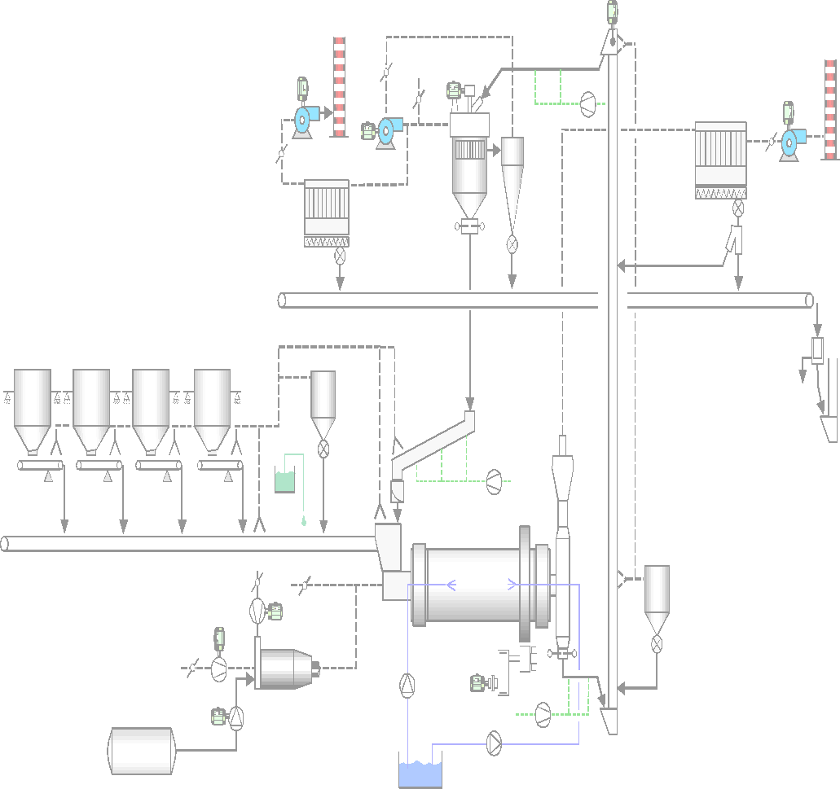
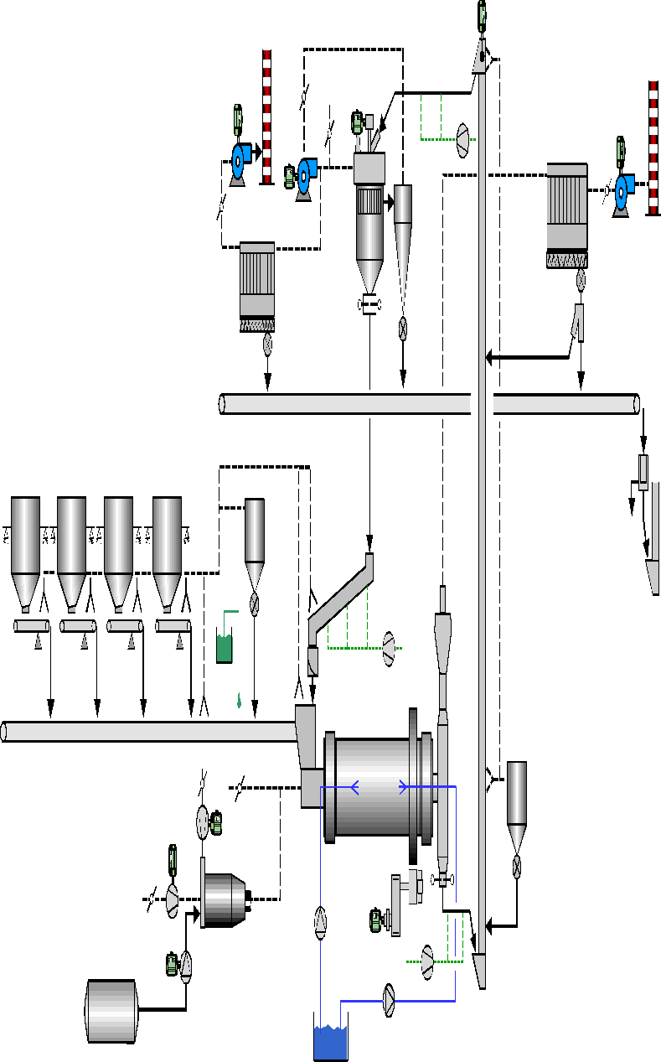
Main areas to be checked to increase ventilation
Filter
Increase the nominal mill ventilation
Check for false air entries
Optimize pressure drop
Check fan efficiency
False Air
Ducting layout
Static separator - cyclones
Fan
Intermediate and outlet diaphragm, and discharge cylinder
False Air
Mill inlet chute
False Air
Mill outlet housing

Slide 25
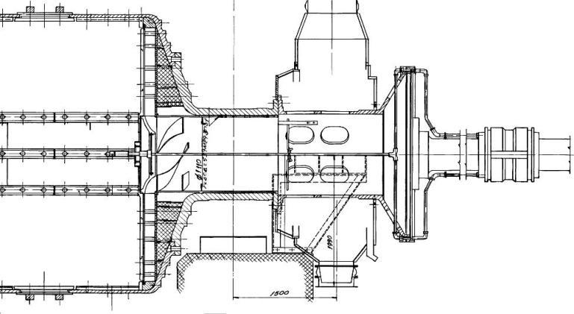
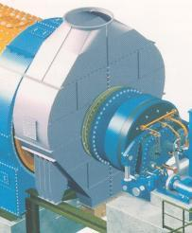
Guide values for gas velocities at mill outlet
Criteria for dimensioning of the mill outlet housing to maintain dust load in dedusting system low
< 4 – 5 [m/s] @ nominal airflow
L x W [m²]
16 – 18 [m/s] @ nominal airflow
Ø d2
Long enough to allow material to fall back to the air slide at the mill outlet
height h = 3 x d1 (preferred)
Long transition
~ 1.5 x d2
Ø d1
)
Pendulum flap (airtight sealing of air slides)
< 4 – 5 [m/s] @ nominal airflow (on the free section of the housing)

Slide 26
Content
Objectives
Purpose of ball mill ventilation
B – level audit of ball mills
Explanation of measurement tasks and requirements
Comparison with guide values
Heat balance of a ball mill system
Drying potential in a ball mill and lack of drying
Cooling potential in a ball mill and lack of cooling
Conclusion

Slide 27
Potential for cooling or drying from ventilation
The available cooling or drying potential in the ball mill is frequently a bottleneck of the grinding system and must be determined by a heat balance
A proper ventilation of the ball mill is a prerequisite to exploit the available cooling or drying potential in the mill.
Minimization of the false air intakes into the mill dedusting is a must before any other further optimization measure
>> 15 [%] false air intake from mill outlet to fan inlet leaves high potential for improvement
Ball mill filter is exclusively used for the dedusting of the mill (and not for additional auxiliary or separator dedusting)

Slide 28
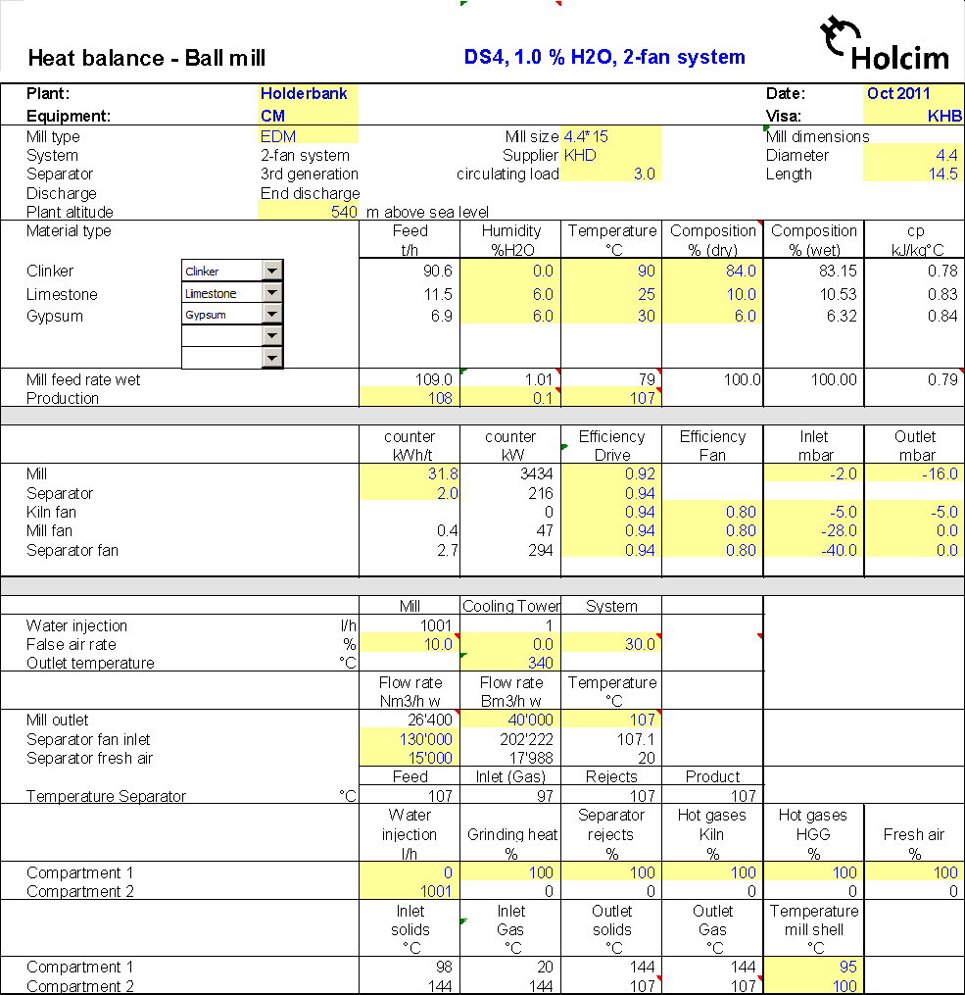
Example HGRS Heat Balance

Slide 29

Basic principle of a heat balance
Under stable conditions it is valid:
Mass _{input} = Mass _{output}
Energy _{input} = Energy _{output}

Slide 30
Basic steps for a heat balance
Define boundary around the system
Identify mass inputs and outputs
Identify energy inputs and outputs
Measure mass and energy inputs and outputs
List all assumptions you plan to work with
Do the heat balance and crosscheck plausibility

Slide 31
Scope of a heat and mass balance
Calculation of production rate (dry) from feed rate (wet)
Air / gas balance of mill and separator
Measurement of mill ventilation
Measurement of separator ventilation (fresh air rate / separator air rate) to calculate reject temperature
Calculation of gas dew point based on amount of water introduced and ambient conditions

Slide 32
Basic calculations for a heat balance
Heat inputs
Sensible heat
Drying gases / cooling air out of mill
Cooling air into separator
Mill Fresh Feed and Separator Rejects
Water injection into mill
False air into mill
Motor power
Mechanical energy converted into heat (100 [%])

Slide 33
Typical border for energy and mass inputs
Energy Inputs
Separator Rejects
Mill Fresh Feed
Hot Gases
Water Injection
False Air
Grinding Energy (motor)

Slide 34
Basic calculations for a heat balance
Heat output
Sensible heat
Mill Product (Dry Fresh Feed and Separator Rejects)
Mill exhaust gases, incl. water vapor
Heat of water heat up and water evaporation
Radiation & Convection losses of mill surface

Slide 35
Typical border for energy and mass inputs
Mill Exhaust Gas
Energy Outputs
Water Evaporation
Mill Product
Radiation & Convection

Slide 36
Typical border for energy and mass inputs
Mill exhaust gas
316 [kJ/kg]
Total heat input / output
17 [kJ/kg]
12’997 [Nm3/h] air @ 108 [°C]
Separator Rejects
Mill Fresh Feed
134 [kJ/kg]
152 [t/h] rejects @ 106 [°C] 0.1 [%] H2O
57 [kJ/kg]
81 [t/h] feed @ 90 [°C], 1.3 [%] H2O
11 [kJ/kg]
Radiation & Convection
Mill Product
240 [kJ/kg]
232 [t/h] @ 115 [°C], 0.1 [%] H2O
Mill fresh air
<1 [kJ/kg]
11’954 [Nm3/h] air @ 25 [°C]
Water evap.
Water injection
48 [kJ/kg]
heat up & evaporation of
490 [l/h] water @ 30 [°C]
Grinding Energy
<1 [kJ/kg]
490 [l/h] water @ 30 [°C]
124 [kJ/kg]
~ 2’960 [kW] @ mill shell

Slide 37
Content
Objectives
Purpose of ball mill ventilation
B – level audit of ball mills
Explanation of measurement tasks and requirements
Comparison with guide values
Heat balance of a ball mill system
Drying potential in a ball mill and lack of drying
Cooling potential in a ball mill and lack of cooling
Conclusion

Slide 38
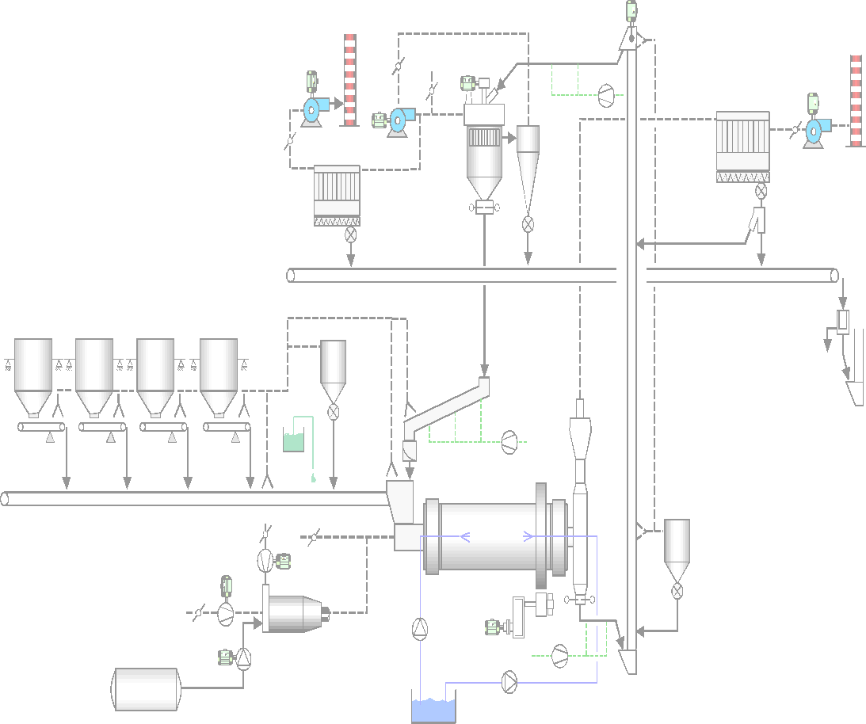
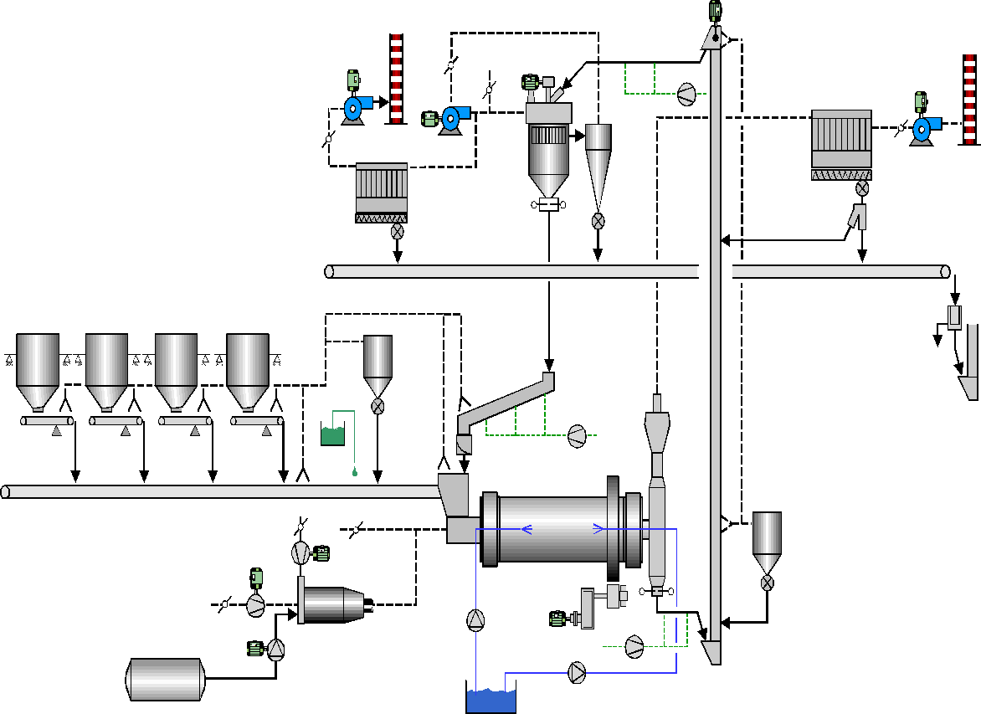
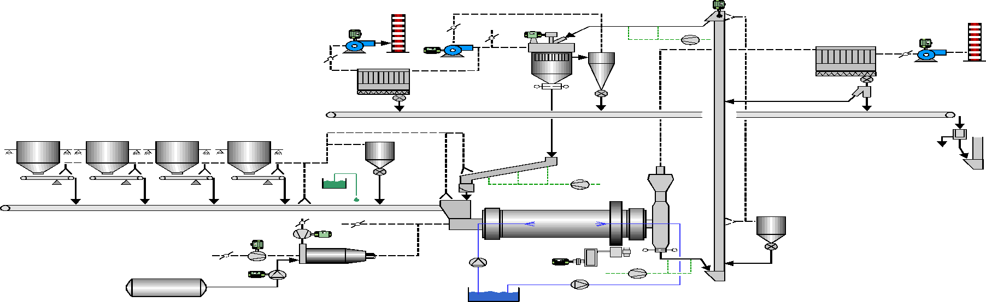
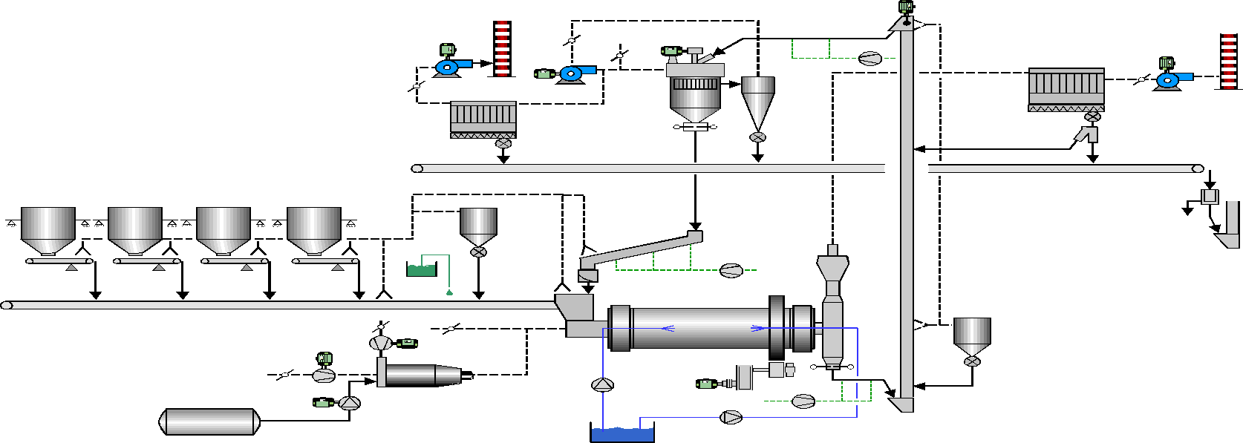
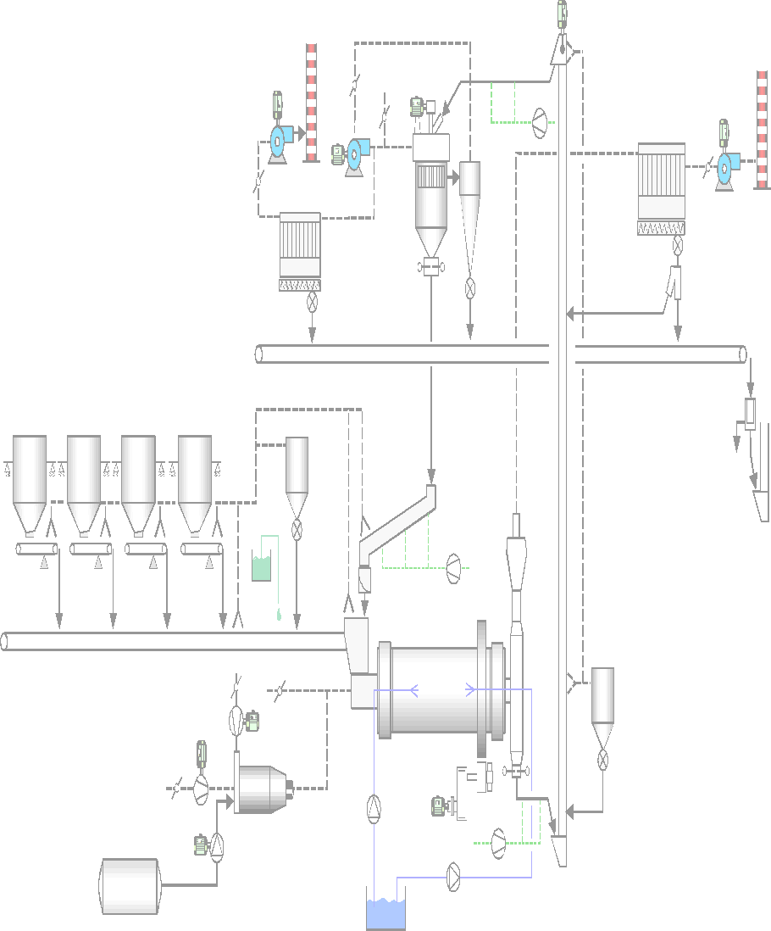
Considerations regarding drying
The drying has to be completed before the end of the 1st chamber to avoid a negative impact on throughput (e.g. blockage of intermediate diaphragm)
Insufficient drying at the mill outlet leads to material handling and storage problems
Temperature of process gas at filter must be > 30 °C above dew point of the gas in order to avoid corrosion problems in the filters

Slide 39
Drying potential depends on heat source & design
 | Drying in the EDM without external sources of heat | Drying in the EDM with external sources of heat | Drying in the EDM with external sources of heat
Additional drying chamber | no | no | yes
Heat source | hot material electrical drives | hot gas (kiln / cooler / hot gas generator) hot material electrical drives | hot gas (kiln / cooler / hot gas generator) hot material electrical drives
Material to be dried | cement | raw material cement | raw material cement
Maximum feed moisture content* | < 3 [%] | < 4 [%] | < 6 [%]
Limit given by amount of hot gas that can be drawn through the mill and the volume of the
drying chamber

Slide 40
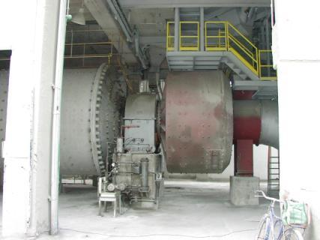
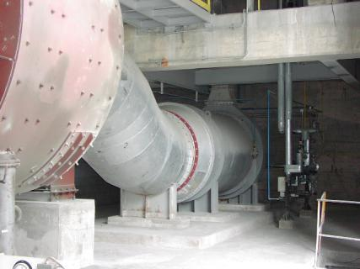
Drying chamber and hot gas generator system
Hot gas generator system
1st ball mill chamber
Drying chamber

Slide 41
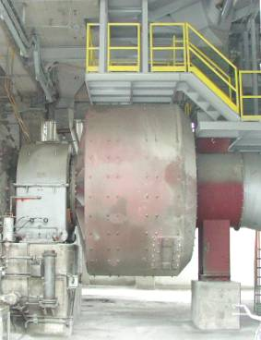
Drying wet components in a drying chamber (1/2)
Specific drying capacity depends on drying chamber volume and hot gas temperature:
Gas temperature [°C]
Spec drying cap. [kgH2O/m3]
300
220
700*
350
*may require an oil cooler for the lubrication of the inlet trunnion
Hot gas temperature at chamber inlet

Slide 42

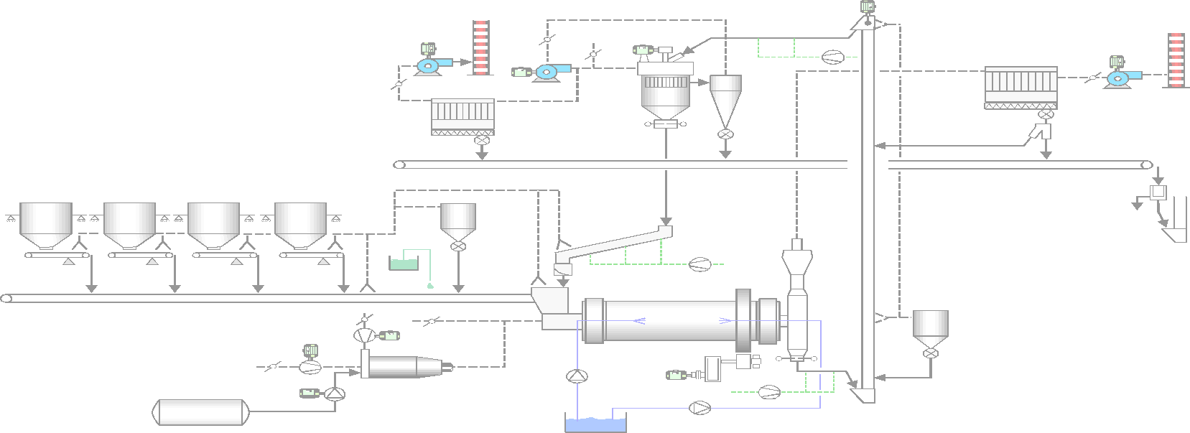
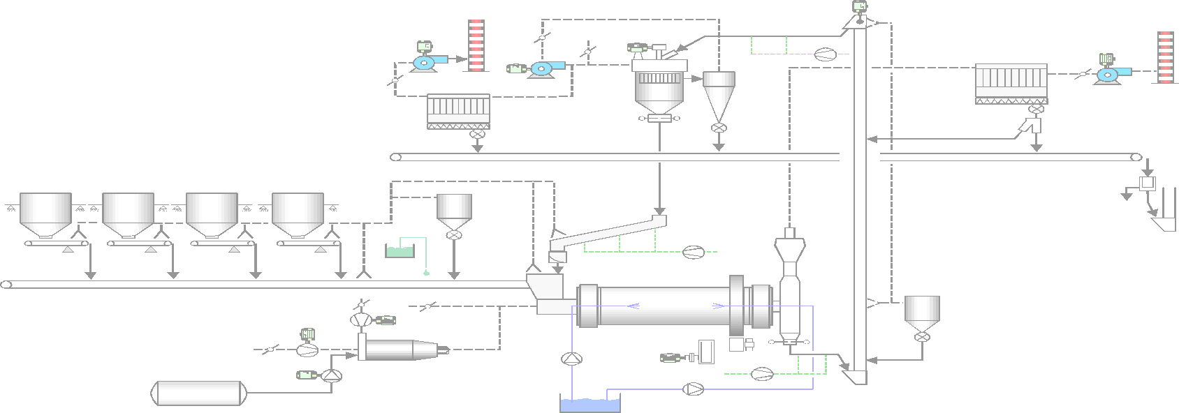
Symptoms of lack of drying
Reduction of throughput and blockage of intermediate diaphragm since drying not completed in 1st chamber
Back spillage and excessive filling degree in 1st chamber
Low gas temperatures at intermediate diaphragm < 65 [°C]
Low mill outlet gas temperatures < 80 [°C]

Slide 43
Possible root causes for a lack of drying
One or a combination of the following causes are possible:
Excess moisture in the mill fresh feed
Low clinker temperature
Low clinker factor
Low mill ventilation, if external heat source available
High mill ventilation, if no external heat source available
High amount of fresh air into the separator
Low power consumption in the mill first grinding chamber

Slide 44
Possible solutions to the drying problem
mill feed properties
Reduce moisture in the mill fresh feed
Cover the fresh feed to guard against dew, rain, snow, etc.
Reclaim the outside stored piles from the top
Manage storage to increase exposure to sun light
Check possibilities of changing feed composition (for example, when feed composed of a mix of wet and pre – dried slag)
Allow rain water evacuation and drainage under the stock piles (especially if water absorption capacity / open porosity of material low)
Increase clinker temperature
Reduce cooler aeration
Reclaim the hottest clinker available in the storage
Reduce storage time or use clinker directly from kiln

Slide 45
Possible solutions to the drying problem
mill feed properties
Increase clinker factor
Only to be changed after all other optimizations finished

Slide 46
Possible solutions to the drying problem
mill ventilation
If no external heat source, but mill ventilation is high:
Reduce mill ventilation looking for an equilibrium between the drying and the grinding processes
Reduced ventilation increases drying potential, but might reduce mill performance (removal of fines, transport,...)
Optimum equilibrium to be found through testing, but watch dew point of gas / air
If with external heat source, but mill ventilation is low:
Increase mill ventilation and amount of hot gases by reducing false air and / or by increasing draft

Slide 47


Possible solutions to the drying problem
mill ventilation
If hot gases from external heat source are reduced through high false air intakes
Reduce false air
False air
Fan gas
Hot gas
Water steam
+
False air
Fan gas
False air
Water steam
Hot gas
False air

Slide 48
Possible solutions to the drying problem
separator ventilation
Reduce fresh air into the separator
In cyclone air separators (2nd & 3rd generation) or 1st generation separator with external dedusting:
Close separator fresh air damper (if needed install a damper and close it)
Keep the separator under smallest possible negative pressure
In single pass separator
Maximize air recirculation from the fan outlet to the separator inlet and close fresh air damper
Install a recirculation duct from the filter stack to the separator inlet, if not available

Slide 49
Possible solutions to the drying problem
mill power
Increase the absorbed power in the 1st chamber
Increasing the absorbed power in the 1st chamber helps in the drying but on the other hand increases the mill motor specific energy consumption:
Evaluate the interest of having a higher production but with higher specific energy consumption
Evaluate impact of increasing absorbed power in the first chamber on the heat balance
Increase stepwise the filling degree in the 1st chamber and follow up the system performance

Slide 50
Content
Objectives
Purpose of ball mill ventilation
B – level audit of ball mills
Explanation of measurement tasks and requirements
Comparison with guide values
Heat balance of a ball mill system
Drying potential in a ball mill and lack of drying
Cooling potential in a ball mill and lack of cooling
Conclusion

Slide 51
Considerations regarding cooling
Excessive grinding temperatures inside the mill can cause:
Material coating on balls and liners, resulting in a performance loss of 5 – 10 [%]
Cement false setting (cement grinding only)
Lump formation in the silos (cement grinding only)
The main option of cooling material in the mill are:
Cooling with water
Cooling with fresh air

Slide 52
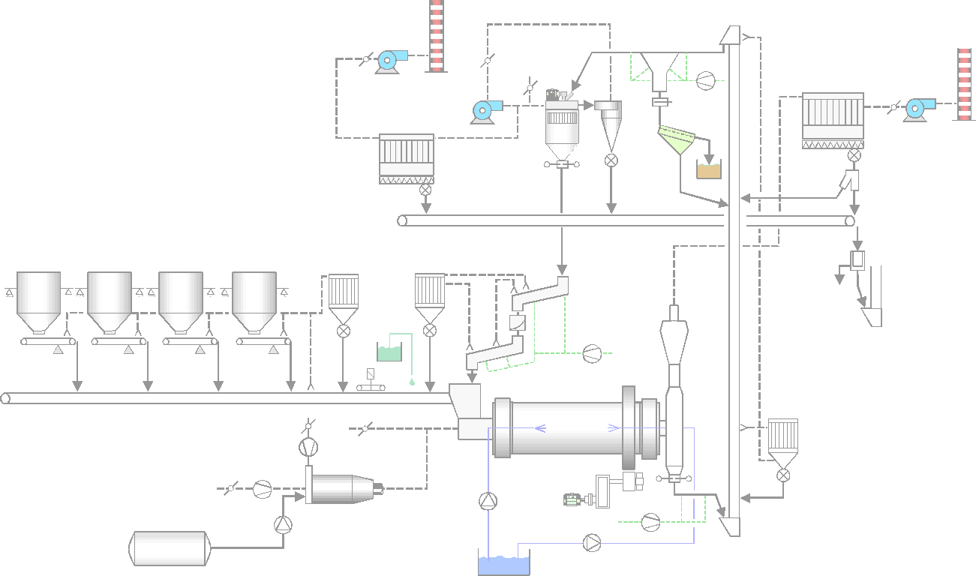
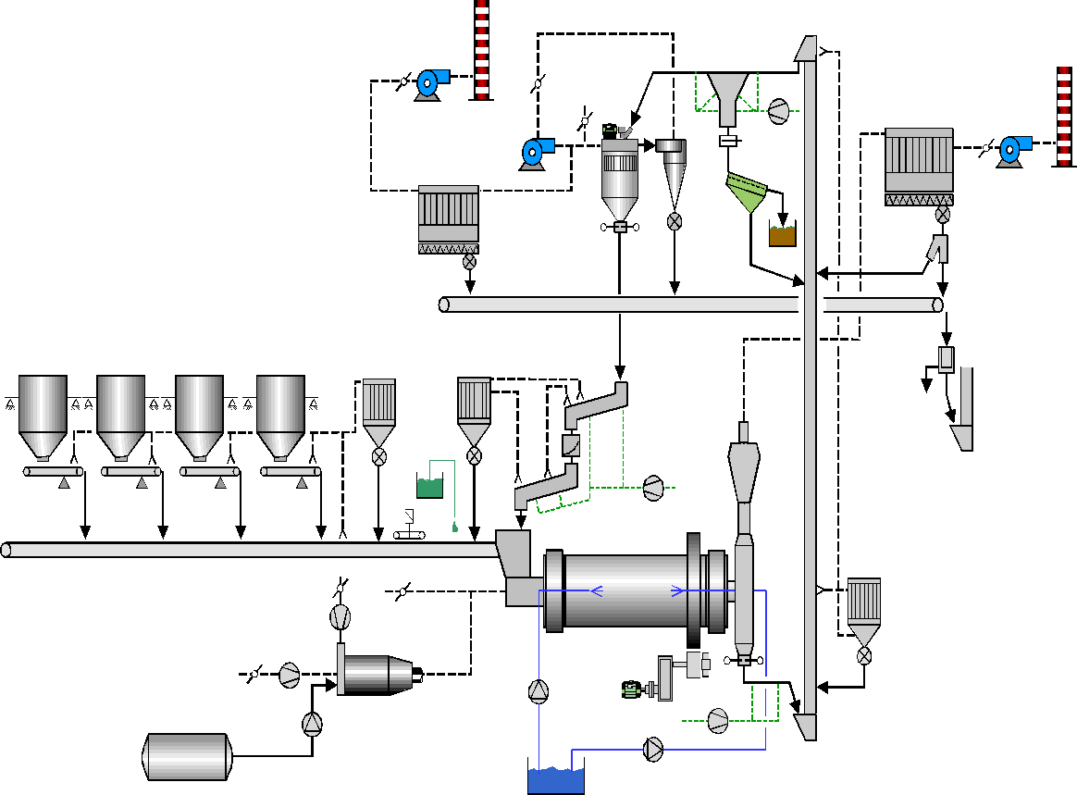
Cooling with water (1/2)
Water has a much higher cooling effect than air
Water acts like a grinding aid (mill capacity increase possible only if injected in 2nd chamber)
Water increases the filter dew point (filter outlet temperature must be 30 [°C] above dew point temperature)
Water injection limited by:
Mill outlet temperature (must be > 100 [°C])
Dew point of gas at mill outlet must be < 56 [°C] (impact on early strengths especially for fine cements with very reactive clinker)
Water injection

Slide 53
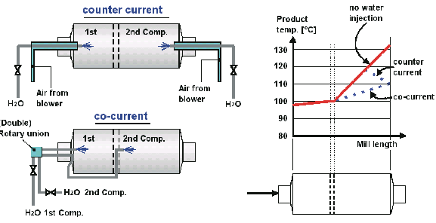
Cooling with water (2/2)
Guide values for amount of water:
If water is required in both chambers (water in 1st chamber only used, if mill feed > 100 [°C] and water spray oriented towards the ball charge)
< 1 % in the 1st chamber & < 2 % in the 2nd chamber
1/3 in the 1st chamber & 2/3 in the 2nd chamber
If water is required only in 2nd chamber
< 2 % in the 2nd chamber

Slide 54

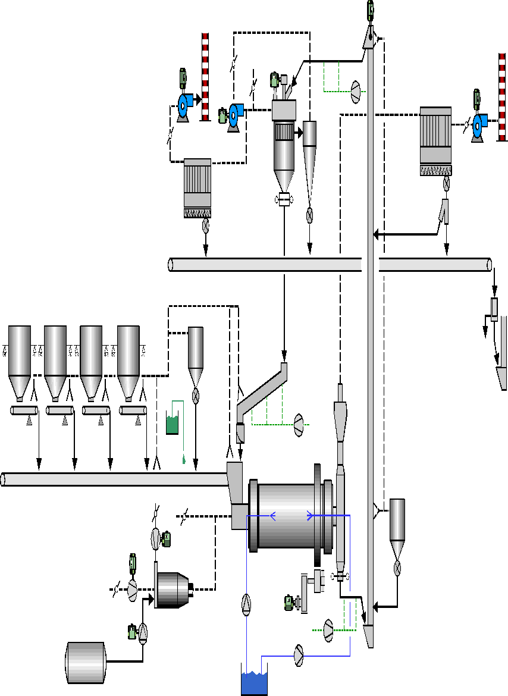

Symptoms of lack of cooling
> 110 - 115 [°C]

Slide 55
Possible root causes for a lack of cooling
One or a combination of the following root causes are possible:
High material feed temperature
Low ventilation through the mill
Too little nominal venting
Operational problems (false air, diaphragm blockage,..)
No / too low water injection in the mill
High specific electrical energy consumption in the mill
Low separator ventilation
Lack of an additional cement cooler

Slide 56
Possible solutions to the cooling problem
mill feed properties
separator ventilation
Reduce the clinker temperature
Review kiln and cooler operation and / or dimensioning
Increase storage time of clinker
Increase moisture content of MIC
Reduce the reject temperature of the separator
Maximize fresh air rate at separator
In case of single pass separators: increase fresh air rate to 100 [%]

Slide 57
Possible solutions to the cooling prob.
mill ventilation
water injection
mill power
Increase the nominal mill ventilation
Check for false air entries at the mill outlet housing, ducting and filter (use mill filter only for the mill and NEVER for dedusting of the mill feeding and transport system)
Modify mill inlet chute to step chute type
Replace the outer ring back plates of the intermediate diaphragm by slotted plates
Increase water injection in the mill
Install a water injection at 2nd chamber
Increase water injection rate (maximum water rate given by maximum dew point of gas of 56 [°C])
Reduce specific power consumption in the mill
Optimize specific electrical energy consumption in the mill (ball charge grading, ball filling degree, feed size,…)

Slide 58
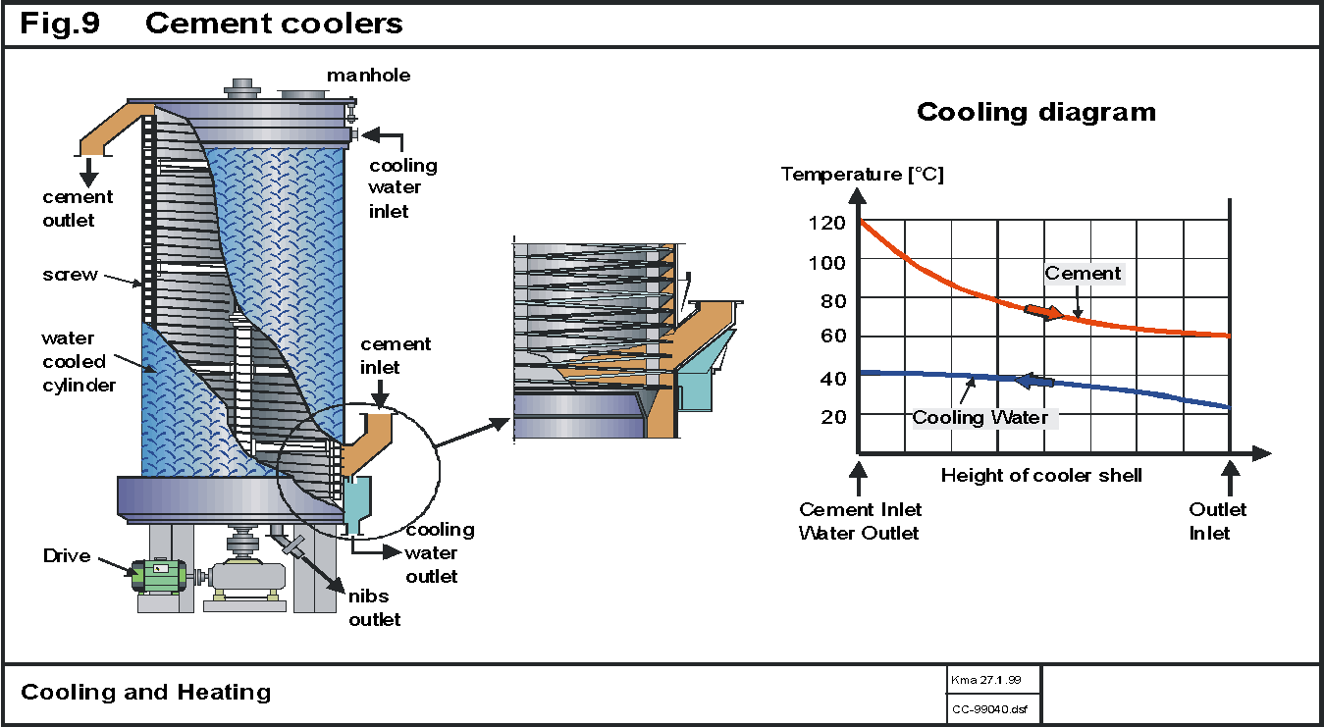
Possible solutions to the cooling problem
cement cooler
Installation of a cement cooler, if low (50 – 60 [°C]) and constant cement temperature required

Slide 59
Content
Objectives
Purpose of ball mill ventilation
B – level audit of ball mills
Explanation of measurement tasks and requirements
Comparison with guide values
Heat balance of a ball mill system
Drying potential in a ball mill and lack of drying
Cooling potential in a ball mill and lack of cooling
Conclusion

Slide 60
Conclusion
Regular ball mill ventilation measurements are key, to maintain a good performance of the grinding circuit
A proper mill ventilation is key not only for cooling and drying, but also for an optimum grinding performance

Slide 61

Questions

